Slide 1
Where AI fits in your business
Which tasks in my company should AI touch first?
Applied AI and Automation | Session 1 of 12
KLAi Professional Learning | Jotham Martin Wambi
Notes:
Welcome. Over twelve sessions you will write an AI use policy, see two automations at work, assess your data readiness, and build a business case and a ninety day plan for your own company. Today we choose the one task that carries you through. Before we start, please name aloud the three candidate tasks you prepared after the Course Overview, one line each.

Slide 2



Today in one view: what you will leave with
By the end of today you will have
A map of ten tasks from your own company, sorted by the kind of tool each one needs
Five tasks scored for value, risk and checkability
One chosen task with a baseline: how long it takes, how often, and where it goes wrong
Notes:
Here is what you leave with today. A map of ten tasks from your company, five of them scored, and one chosen task with a baseline. Everything we build in later sessions works on that one task, so we take care over the choice. We start from your three candidates, and you may change your mind as the evidence comes in.

Slide 3
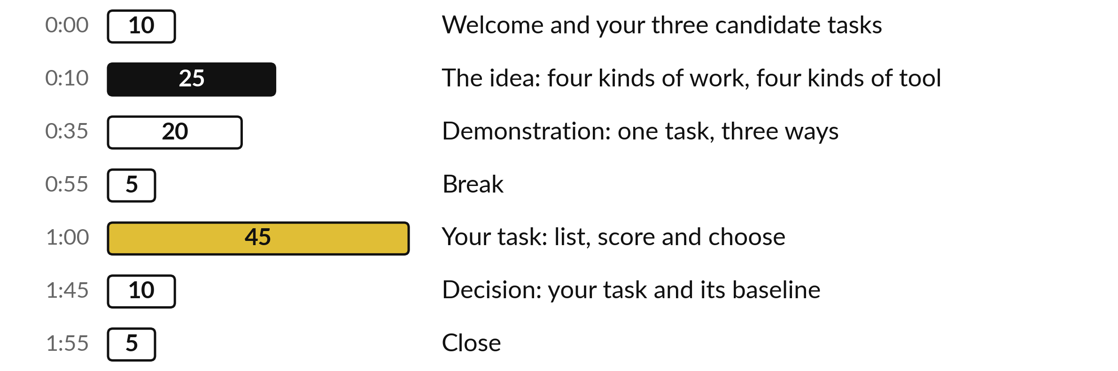
Your two hours: most of
the time is your own work
45 of the 120 minutes are yours, working on your own company.
Notes:
Three parts matter most today. I talk for twenty-five minutes about the four kinds of work and the tests for a good first task. Then I run a demonstration for twenty minutes. After the break, forty-five minutes are yours, working on your own company. If a part runs long, I shorten my talking and keep your working time.

Slide 4




Words we use today
Word | What it means
Task | One piece of repeated work with a clear start and finish, such as the weekly sales email.
Use case | A task plus the tool you would use and the result you expect.
Baseline | How the task performs today: time, volume, errors and cost. It is the number you must beat.
Checkable | A result you can confirm quickly against a source, so a mistake is caught before it matters.
Notes:
Four words for today. I give the plain meaning of each, and we use every one of them before the end of the session.
Task. One piece of repeated work with a clear start and finish, such as the weekly sales email.
Use case. A task plus the tool you would use and the result you expect.
Baseline. How the task performs today: time, volume, errors and cost. It is the number you must beat.
Checkable. A result you can confirm quickly against a source, so a mistake is caught before it matters.

Slide 5
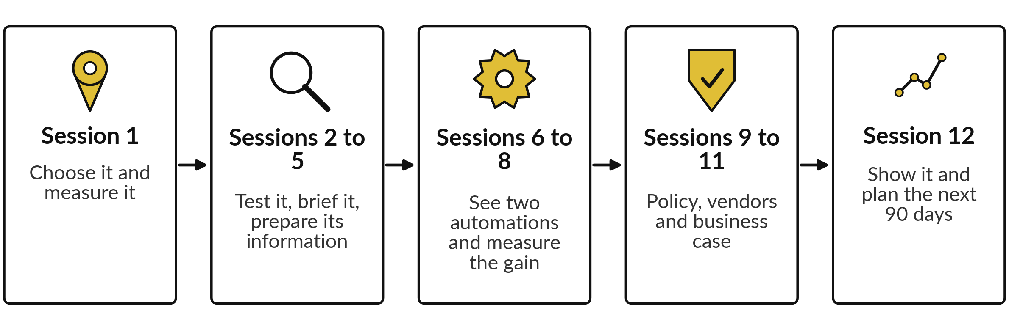
How your own task travels through the course
One task, followed from choice to a result you can show.
Notes:
Before the idea, here is where we are going. Today you choose one task from your company and measure it. In sessions two to five you test it for mistakes, brief an AI tool and prepare its information. In sessions six to eight I show you two automations, one by rules and one with AI, and we measure the gain.
Then you write the policy, question vendors and write the business case. In session twelve you show it. One task followed all the way through is worth more than twelve separate exercises, so the choice you make today matters.

Slide 6
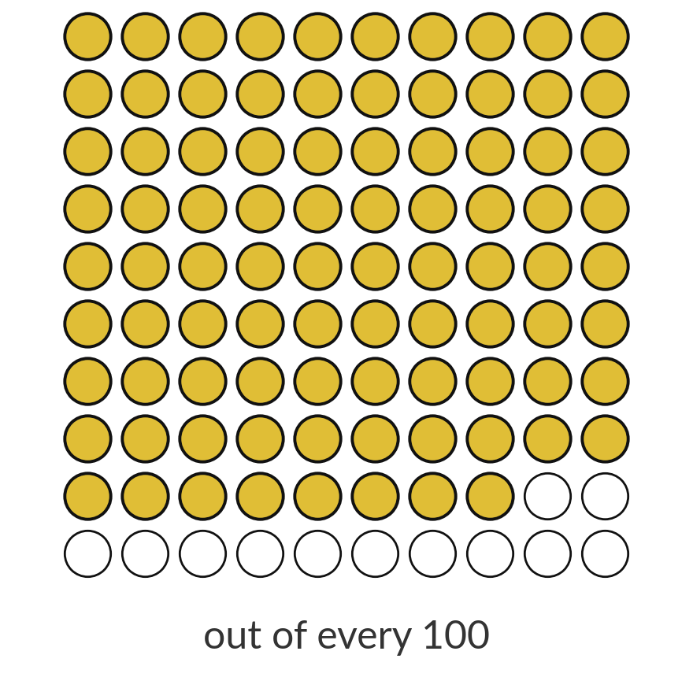
Most companies use AI, and
far fewer see a profit from it
88%
of companies use AI in at least one function. About 39% report any effect on profit.
Source: McKinsey, The State of AI 2025, survey summary; large global firms
Notes:
Start with the gap. In a large 2025 survey, almost nine in ten companies said they use AI somewhere. Fewer than four in ten could point to any effect on profit. Those are big, mostly global firms, so treat the exact numbers with care. The lesson holds anywhere: using AI and gaining from it are different things.
The difference is choosing the right task and measuring it. That is what we do today, and the next picture shows how to choose.

Slide 7
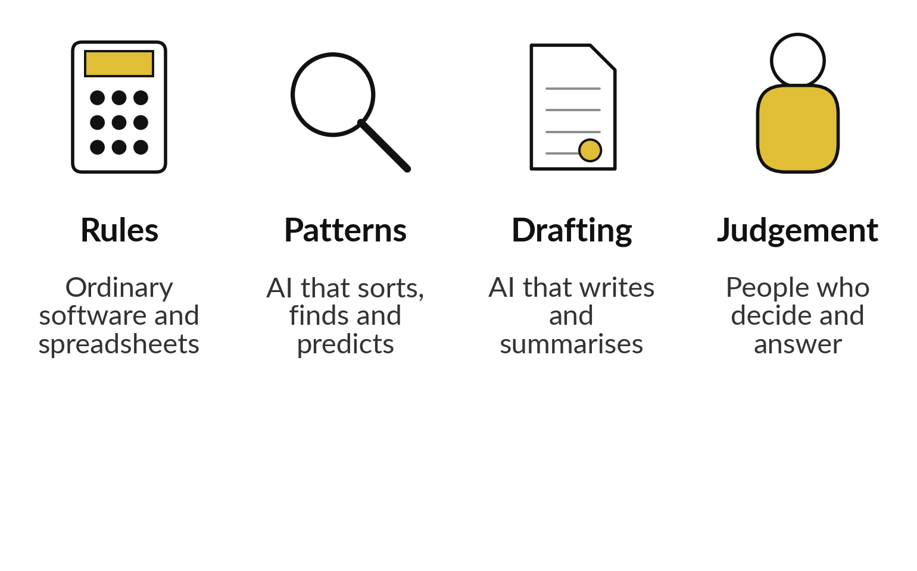
Four kinds of work, four kinds of tool
Match the work to the tool before you pick the product.
If a rule can do it, use a rule.
AI helps where the input is messy text.
People keep the decisions that carry risk.
Notes:
Four kinds of work. Rules are for work with a fixed answer, like adding invoice totals. A spreadsheet does that better than any AI. Patterns are for sorting and finding, like putting customer messages into types. Drafting is for writing and summarising. Judgement stays with people, for example whether to refund a customer or hire a candidate.
An easy way to waste money is to use AI where a formula would do. The other mistake is handing judgement to a tool. Match the work first, and then choose the product.

Slide 8





Five tasks from one company,
and the tool each one needs
Task at Nile Valley Foods | Kind of work | Why
Add up the week’s invoices | Rules | A formula gives one exact answer.
Sort 200 customer messages by type | Patterns | Messy text, but easy to check.
Draft the Monday sales email | Drafting | Data in, readable summary out.
Decide a refund over UGX 500,000 | Judgement | Money and trust are at stake.
Shortlist 80 CVs for a driver post | Patterns, with care | Bias risk, so a person decides.
Invoice totals, duplicates and missing purchase order numbers are all rules. Session 11 costs that check.
Notes:
Here is one company, Nile Valley Foods, a food distributor in Jinja, and five of its tasks. Adding invoices is a rule, so use a formula. Spotting duplicate invoices and missing purchase order numbers is also done by rules in code, and in Session 11 we cost that kind of check.
Sorting messages is a pattern job, and you can check it. The Monday sales email is a drafting job. A refund over five hundred thousand shillings is judgement, so a person decides. CV shortlisting is a pattern job with a bias risk, so a person decides too. Notice that only some tasks need AI at all.

Slide 9
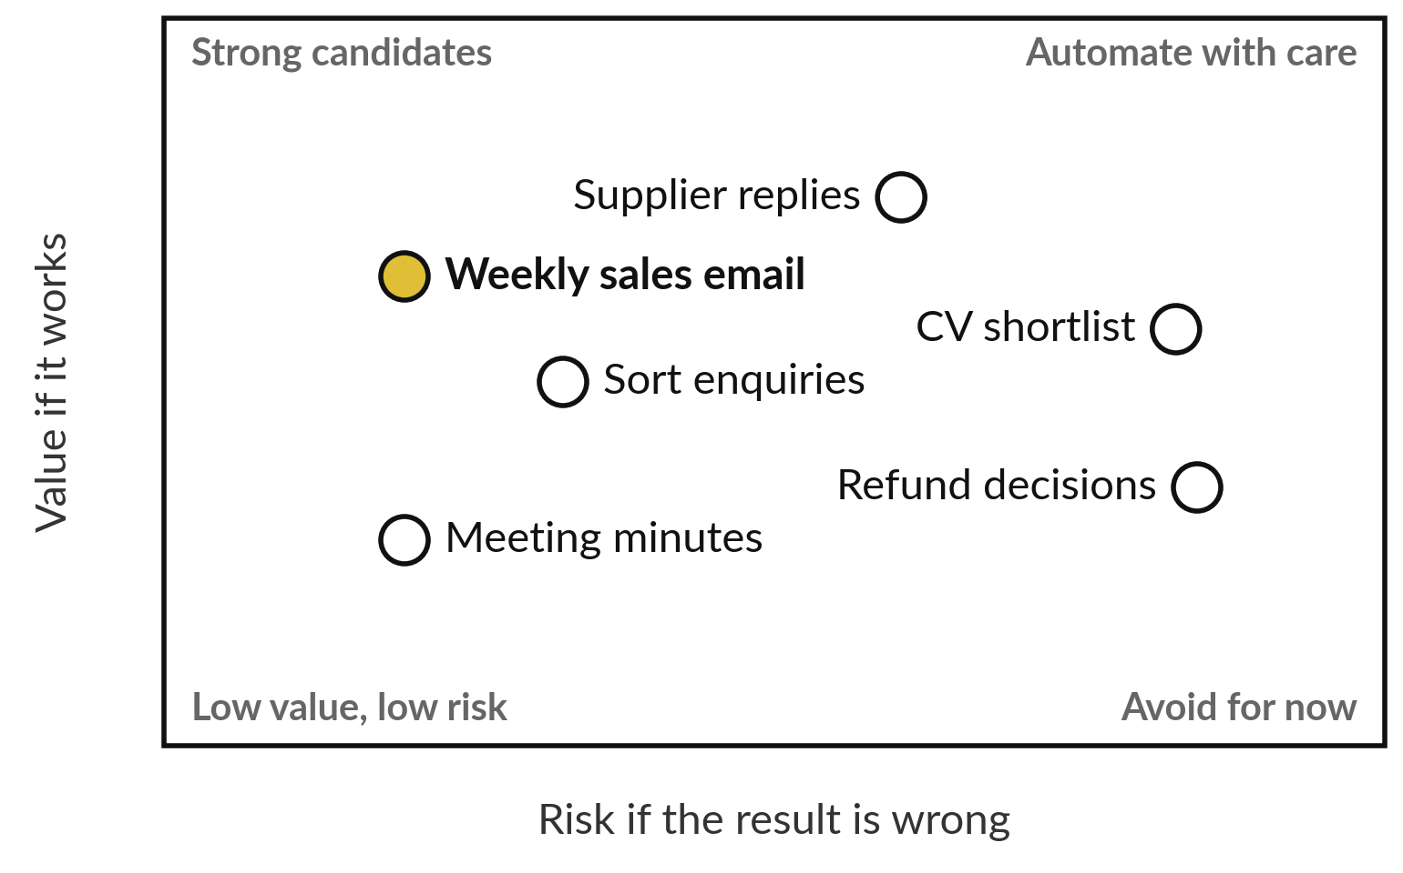
A good first task is valuable,
safe and easy to check
Start where value is high and a mistake is cheap.
Plot your own tasks like this.
Move right only when you can check results.
Your first pick sits top left.
Notes:
This is the picture to carry in your head. Across, the risk if the result is wrong. Up, the value if it works. The top left is where you start, with high value and low risk. The weekly sales email sits there. Replies to suppliers have good value but more risk, so they need a checking step.
Refund decisions sit far right, and you do not give those to a tool. Later in this session you place your own tasks on this picture.

Slide 10






A good first task passes at
least five of these six tests
It happens often, at least weekly.
The inputs exist as text, files or a sheet.
You can check a result in a few minutes.
A mistake is caught before a customer or the bank sees it.
One person owns it and will use the result.
You can measure it today: time, volume, errors.
Notes:
Six tests, and I would like your task to pass at least five. It happens often, so the saving adds up. The inputs exist as text or files. You can check a result in minutes, and a result you cannot check is a result you cannot trust. A mistake is caught before it leaves the building.
Someone owns it. And you can measure it today. A task that fails the checking test or the ownership test is a poor first choice, however exciting it looks.

Slide 11
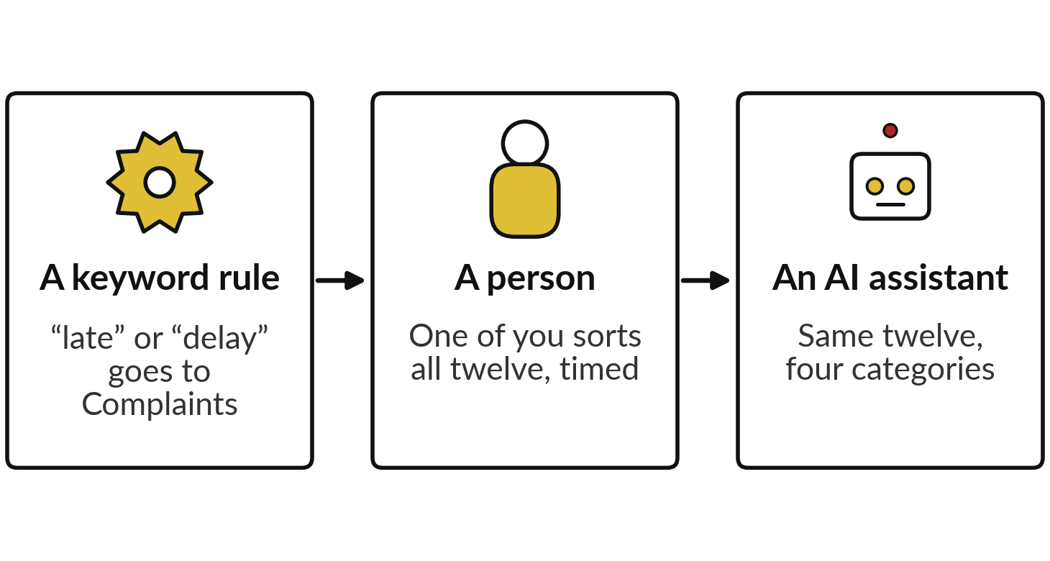
Demonstration: sort twelve
customer messages three ways
I will show
Watch for
Which messages the rule gets wrong.
Whether the AI is sure and still wrong.
How long checking the AI takes next to doing it by hand.
Notes:
Now I show one task three ways. We use twelve customer messages from Nile Valley Foods and four categories: order, payment, complaint or other. First a keyword rule in a spreadsheet: any message containing late or delay goes to Complaints. Then one of you plays the person and sorts the same twelve by hand while I time you.
The rule and the AI results are saved on the next slides, so we spend our time on what they mean and not on switching tools. Watch which messages the rule gets wrong, whether the AI is sure and still wrong, and how long checking takes next to sorting by hand.

Slide 12
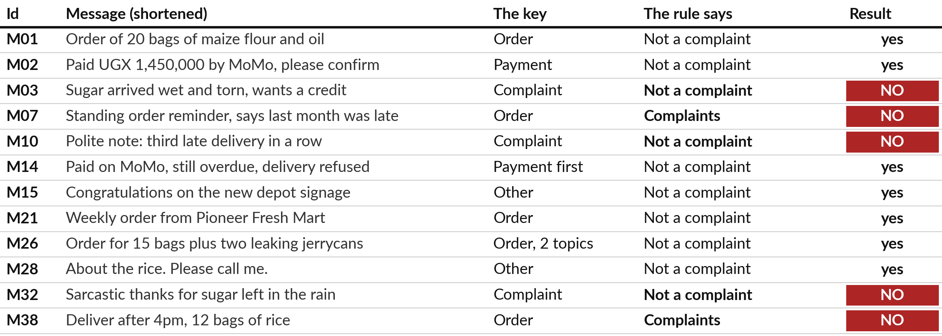
The keyword rule on the sheet
is right for 7 of 12 messages
It files M07 and M38 as complaints and misses M03, M10 and M32.
Notes:
Here is the keyword rule applied to all twelve messages, so we do not need to switch tools. The rule files a message under Complaints if it contains the word late or delay. On the question is this a complaint, it is right for seven messages and wrong for five.
It wrongly files M07, a polite reminder of a standing order, and M38, a delivery time request, as complaints. It misses three real complaints: M03, the damaged sugar, M10, the very polite note about three late deliveries, and M32, the sarcastic thank you. The rule is exact and fast. It simply cannot read meaning.

Slide 13
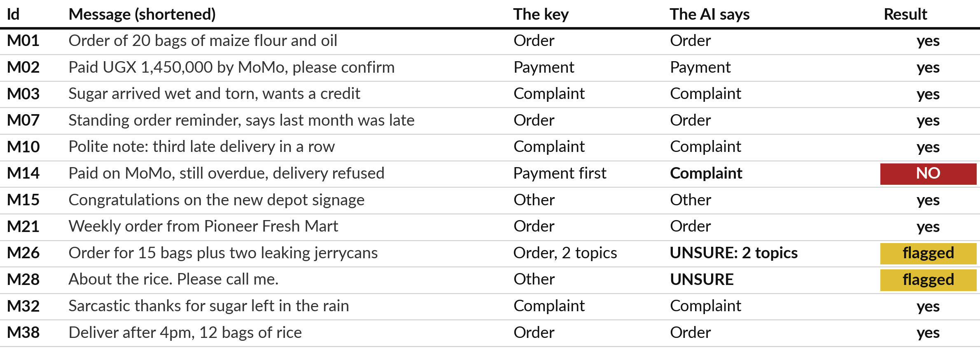
The AI sorted the same twelve: 9
match the key and 2 are flagged
Three separate runs gave these same answers. Run with Claude, 4 November 2026.
Notes:
Here is what an AI assistant did with the same twelve messages and one plain prompt. I ran it three times in fresh sessions given only the prompt, with the answer key hidden, and it gave the same answers each time. This was Claude, run on the fourth of November 2026.
It was not ChatGPT or Gemini, and another day or another product can differ. Nine answers match the key. It got right all four messages that fooled the rule: M07, M10, M32 and M38. For M26 and M28 it said unsure, which is what a careful person would do.
The one disagreement is M14, where it chose Complaint and the key says the payment problem comes first.

Slide 14


Rule, person and AI side by side
Method | Time | Right, out of 12 | Where it goes wrong
Keyword rule | Seconds | 7 | Reads words, not meaning: M07 and M38 wrong, M03, M10, M32 missed
A person | Your class time, on the board | Your class score | Slow and tiring. People differ on M14, M26 and M28
AI assistant | A few seconds to answer, then minutes to check | 9 match the key, 2 flagged | Chose Complaint for M14. Needs a person to check
The AI figures are three runs with Claude on 4 November 2026. Another product or day may differ.
Notes:
Now the three side by side. The rule takes seconds and is right for seven of twelve. The person takes the time we measure in this room and, as we saw, people disagree about the mixed messages. The AI answers in a few seconds, but checking its twelve answers takes minutes, and it matched the key on nine with two flagged.
None of the three is perfect, and each fails differently. The rule fails on meaning. The person fails on speed and consistency. The AI fails by sounding sure while making a judgement call. Which failure would hurt your company least?

Slide 15


What the AI got right, and
what still needs a person
Right where the rule failed
Still needs a person
M07, M10, M32 and M38 all correct
UNSURE for M28
Two topics seen in M26
M14: Complaint, but the key says Payment first
Twelve messages is a small sample
Reasons read well even when debatable
A person checks, and the cost of a mistake decides how much checking.
Notes:
So what does this tell us?
Left side: the AI read meaning where the rule only read words. It handled politeness, sarcasm and a delivery time that merely contains the word late, and it said unsure when it truly could not tell. Right side: it still made a call on M14 that Finance may disagree with.
Twelve messages is a small test, and a fluent reason is not proof. This is why we pick a first task that is easy to check, and why the cost of a wrong answer decides how much checking is enough. Session 2 shows more cases where AI is right and wrong, and the checks to use.

Slide 16
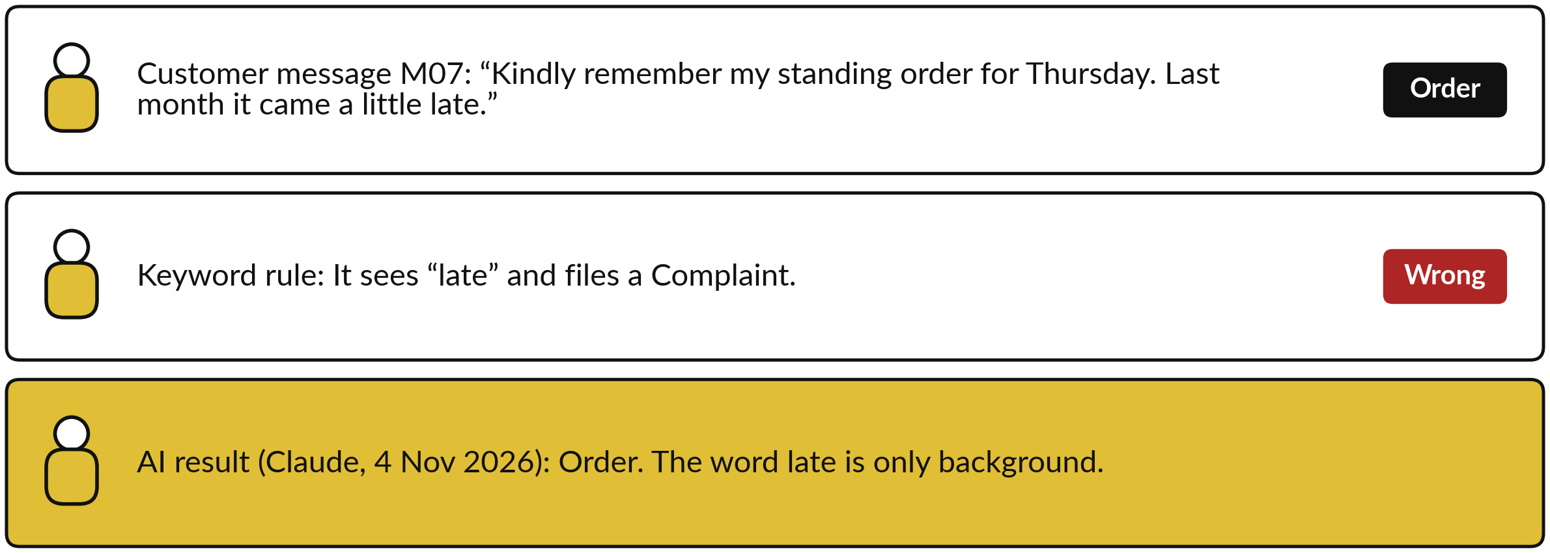
The messages that fool a keyword rule
Rule: “late” or “delay” means Complaints.
Notes:
Here is a message the rule gets wrong. It is message M07 from the customer messages of Nile Valley Foods. The customer is polite and is reminding us of a standing order, but the word late appears, so the rule files a complaint. A keyword rule cannot read meaning.
It also misses real complaints that use neither word, such as M10, which is written very politely. In our three runs the AI assistant read the whole sentence and got M07 right. It had a wrong case of its own, M14, which is why checking matters as much as choosing.

Slide 17
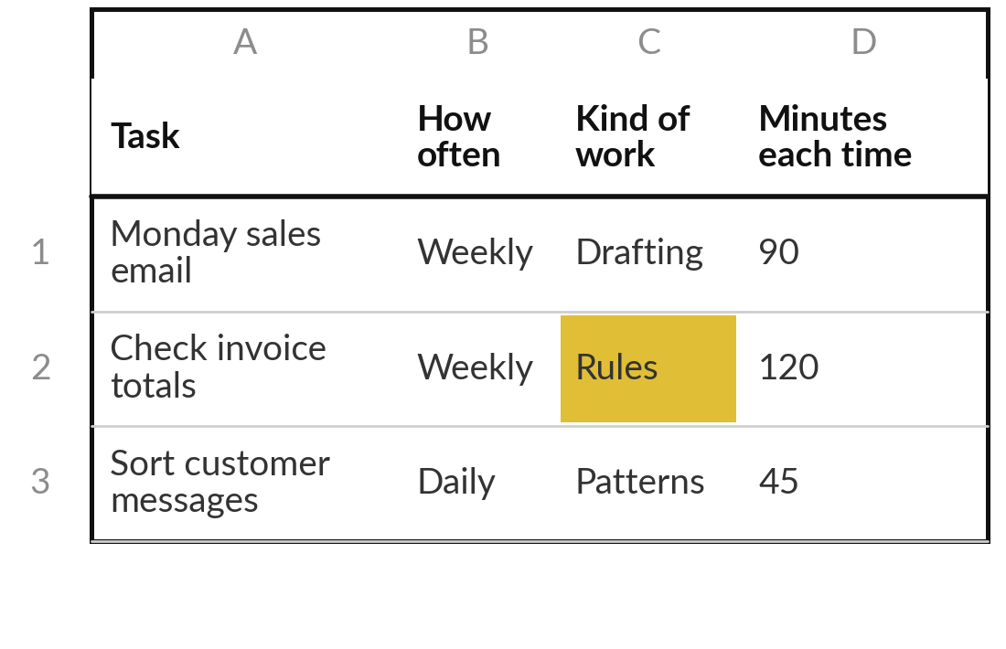
Practice: list ten tasks and
sort them by kind of work
15 minutes
Your own company task
List ten recurring tasks from your own company.
Start with your three candidates, then add seven more.
Write each task in one line on the scorecard.
Mark each one: rules, patterns, drafting or judgement.
Cross out any task that needs only a rule.
You keep: A scorecard with ten tasks, each marked with the kind of work it is.
Notes:
Take fifteen minutes. Open the scorecard and list ten recurring tasks from your own company, starting with the three candidates you named at the beginning. Think of work that happens weekly or monthly, in finance, sales, operations, people or customer service. Mark each task with its kind of work.
If a task only needs a rule, a formula or a better spreadsheet, cross it out as an AI candidate. I will walk round and read your lists with you.

Slide 18
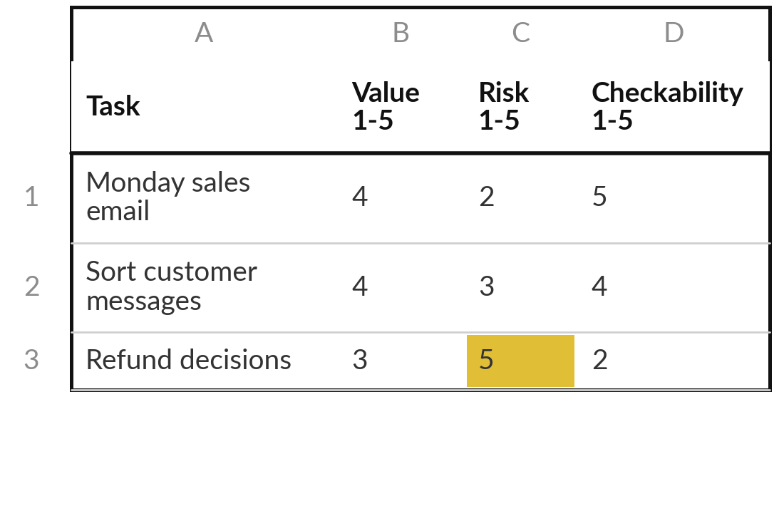
Practice: score five tasks and
place them on the picture
15 minutes
Your own company task
Score your five best tasks for value, risk and checkability.
Pick five tasks from your list.
Score each 1 to 5 for value, risk and checkability.
Plot each on the value and risk picture.
Mark any task that fails the six tests.
You keep: Five scored tasks and a plot showing your top left candidates.
Notes:
Another fifteen minutes. Choose five tasks. Score each from one to five for value, for risk and for how easily you can check the result. Then plot them on the picture. Use the six tests: if a task passes fewer than five, mark it as a weak first choice.
Be strict about risk. If a mistake would reach a customer or the bank before anyone checked, the risk score is high. When you finish, point to the task you are leaning towards, and say one reason aloud.

Slide 19








A finished task card from Nile Valley Foods
Field | Example from Nile Valley Foods | E or M
Task | Draft and send the Monday sales summary email to the directors | -
Owner | Peter Okello, Sales Manager | -
How often | Every Monday at 8:00 | M
Time today | 90 minutes, one person | E
Volume | 4 emails a month, each covering 6 regions and 5 products | M
Hours a month | 4 x 90 minutes = 6 hours | E
Usual errors | Wrong week selected, or two figures mistyped, in 4 emails out of 10; one error costs about UGX 150,000 | E
What better means | Draft ready in 10 minutes, checked in 20 minutes, no wrong week | E
E means estimate. M means measured: someone timed or counted it.
Notes:
Here is a finished task card from the case company, so that you can see the level of detail before you write yours. Each number has a letter beside it. E means estimate, your best guess. M means measured, because someone timed or counted it. Look at the usual errors line.
It says how often the task goes wrong and what one error costs. Notice that the numbers are small and specific. You do not need a study. You need a plain estimate, marked as an estimate, that we improve later in the course.

Slide 20
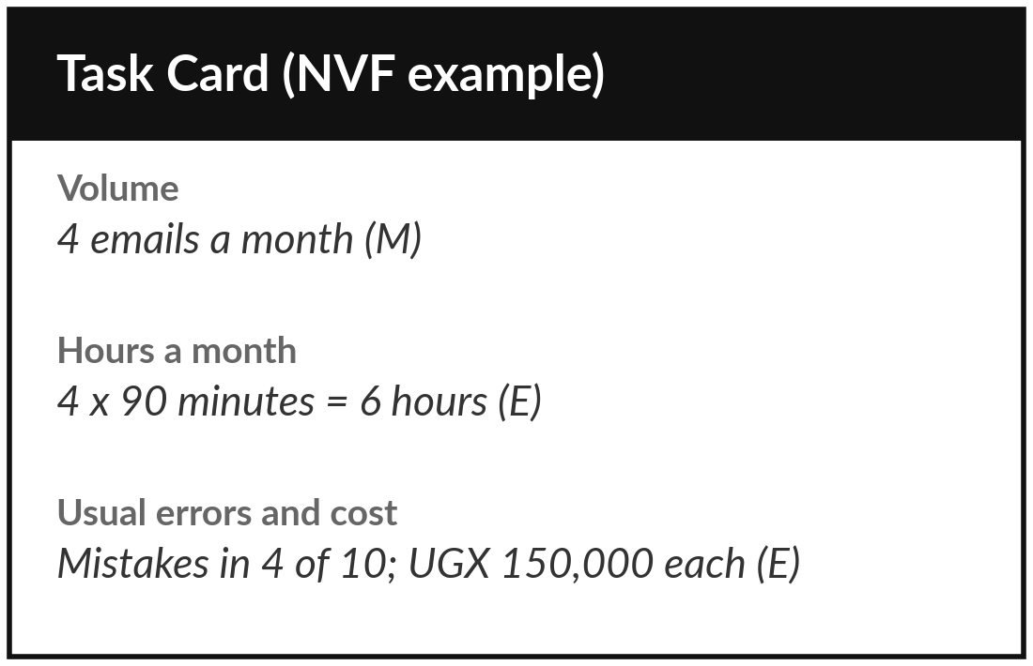
Practice: choose one task and write its baseline
15 minutes
Your own company task
Write the task card for the one task you will carry through the course.
Name the task and its owner.
Write how often, how many a month, minutes each time and hours a month.
Write the usual errors and what each costs.
Mark every number E (estimate) or M (measured).
Write what better means, as a number.
You keep: A one-page task card with a baseline: volume, hours, errors and cost.
Notes:
Last fifteen minutes of your own work. Choose the one task and write its task card, using the finished card as your guide. Name the owner. Write how often it happens, how many a month, how long each one takes and so how many hours a month. Write the usual errors and what each one costs.
Mark every number E for estimate or M for measured. Then write what better would look like, as a number you can check. If you do not know a number, estimate it and mark it E.

Slide 21



Decision: which task will you
carry through the course?
Which of your top three tasks do you choose?
The safest
The biggest saving
The most visible
Low risk, easy to check. You will finish and learn the method.
Highest value. Needs more care and a stronger check.
Staff or the board will notice. A good proof, if it passes the tests.
Record your choice and one reason on the task card.
Notes:
Time to decide. Which of your top three do you choose?
The safest, which is low risk and easy to check, so you will finish and learn the method. The biggest saving, which has the most value but needs a stronger check. Or the most visible, which proves the point to your team. My advice for most executives is the safest task that still saves real time.
You can repeat the method on the bigger one later. Say your choice and your reason aloud, and then write them on the card.

Slide 22
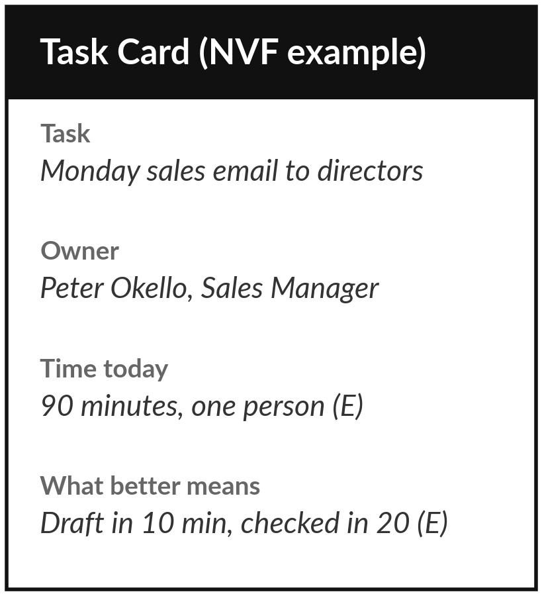
Save your scorecard and task card for Session 2
What you keep from today
Your completed use-case scorecard and one-page task card. This task stays with you for the whole course.
Our question today
Which tasks in my company should AI touch first?
Next session
Session 2: How AI works and where it fails. Nothing to bring: we use the case company.
Notes:
Save the scorecard and the task card where you can find them, because we use them again in Session 2. One optional thing before then: notice one moment this week when your chosen task goes wrong or wastes time, and write it down. In Session 2 we look at where AI fails, using the case company.
We began with this question: Which tasks in my company should AI touch first? Before you go, say in one sentence what you can now say about it.

